Slide 1
NEAT vs DEAP

Slide 2
Copy Task
In the copy task the network has to store and recall a long sequence of random binary vectors. The network is given a single bit to indicate the start of the exercise, a sequence of random bit vectors, and a delimiter bit to signal the beginning of the recall phase. The sequence is of 8-bit length.
Copy Task has been tested with both NEAT and DEAP with the following parameters.
NEAT (population size: 400 and 500 generations).
DEAP (population size: 100 *4 trees and 250 generations).

Slide 3
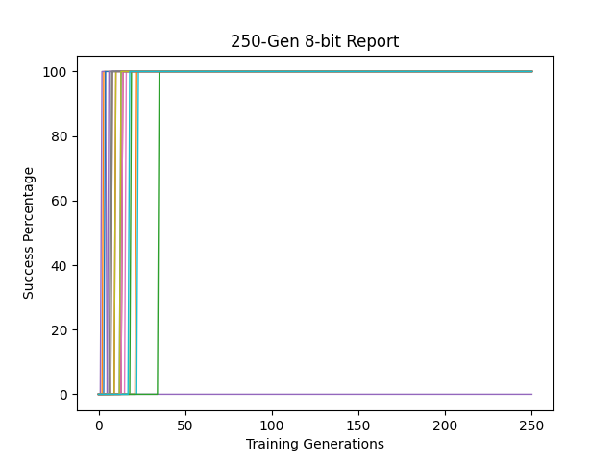
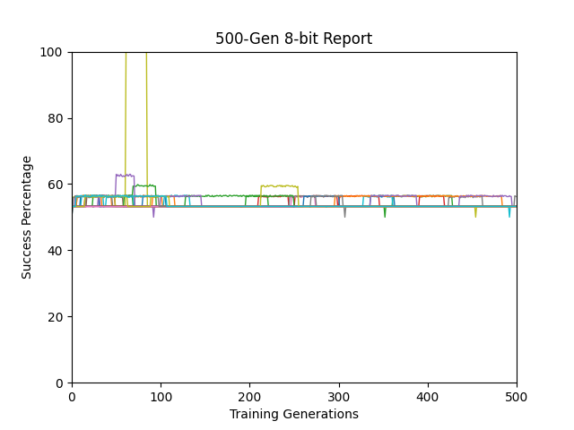
DEAP Results (20 run)
NEAT Results (20 run)
Results generated from testing champion of every generation against new set of data (50 example) that has never been seen before
Results generated from training fitness of every generation champion

Slide 4
Sequence recall
In this experiment the network is given a series of instructions marked with bits and then a random countdown would start, when the countdown reaches zero, the network would have to execute one of the instructions in the same order it was given.
We have different depths (instructions) for this experiment and random countdowns within the same sequence.
We’ll show results from 4, 5, 6, 15 and 21 deep tests.
NEAT was given an edge in this experiment (500 generation, 400 population) over DEAP (250 generation, 400 population)
Whenever a network reached 100% fitness we stopped training for it.

Slide 5
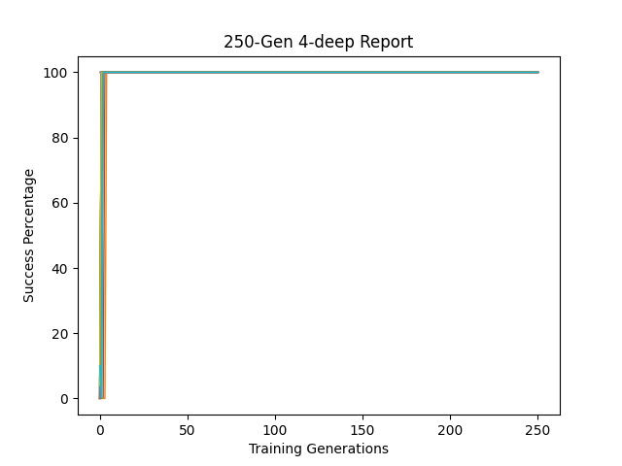
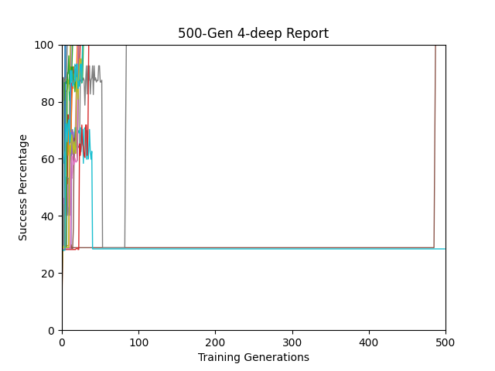
DEAP Results (20 run)
NEAT Results (20 run)
Results generated from testing champion of every generation against new set of data (50 example) that has never been seen before
Results generated from training fitness of every generation champion

Slide 6
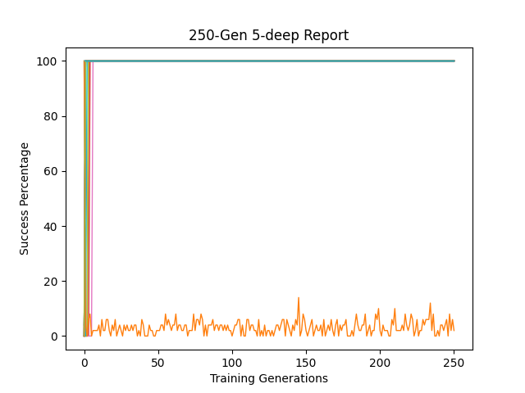
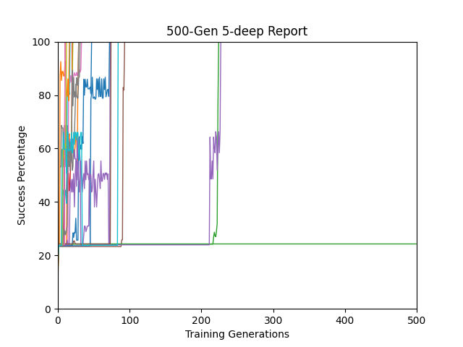
DEAP Results (20 run)
NEAT Results (20 run)
Results generated from testing champion of every generation against new set of data (50 example) that has never been seen before
Results generated from training fitness of every generation champion

Slide 7
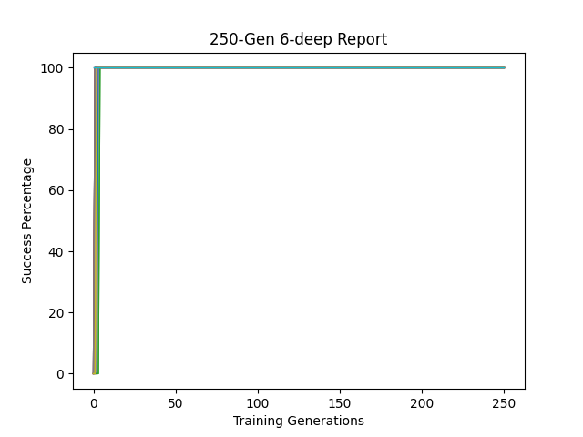
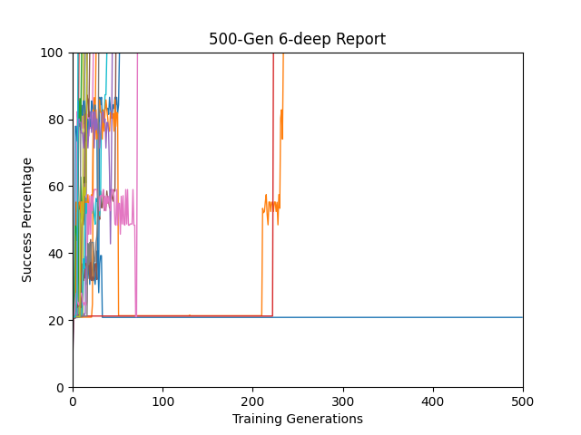
DEAP Results (20 run)
NEAT Results (20 run)
Results generated from testing champion of every generation against new set of data (50 example) that has never been seen before
Results generated from training fitness of every generation champion

Slide 8
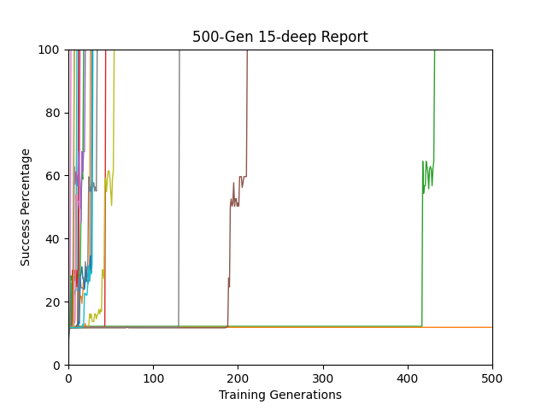
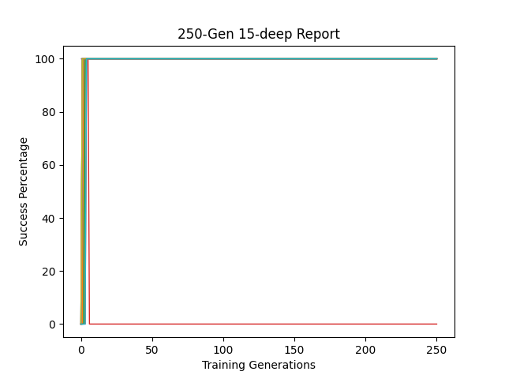
DEAP Results (20 run)
NEAT Results (20 run)
Results generated from testing champion of every generation against new set of data (50 example) that has never been seen before
Results generated from training fitness of every generation champion

Slide 9
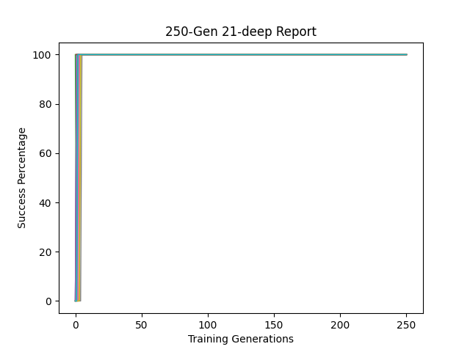
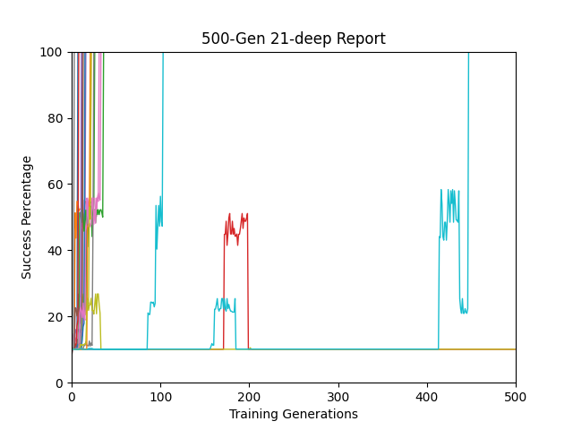
DEAP Results (20 run)
NEAT Results (20 run)
Results generated from testing champion of every generation against new set of data (50 example) that has never been seen before
Results generated from training fitness of every generation champion

Slide 10
Sequence classification
In this experiment we give the network a sequence of numbers (1 and -1) with a random number of noise in between (zeros), at the end of the sequence the network should be able to determine if the total is positive or negative.
We have different depths (instructions) for this experiment and random number of noise within the same sequence.
We’ll show results from 4, 5, 6, 15 and 21 deep tests.
NEAT was given an edge in this experiment (500 generation, 400 population) over DEAP (250 generation, 400 population)

Slide 11
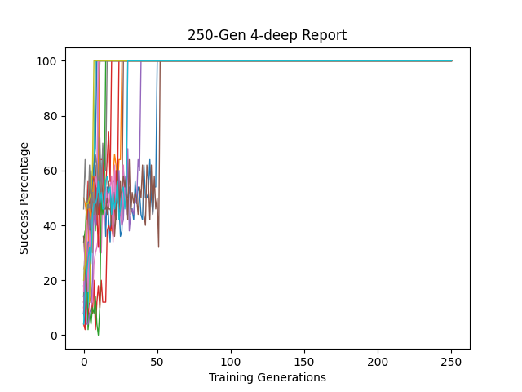
DEAP Results (20 run)
NEAT Results (20 run)
Results generated from testing champion of every generation against new set of data (50 example) that has never been seen before
Results generated from training fitness of every generation champion

Slide 12
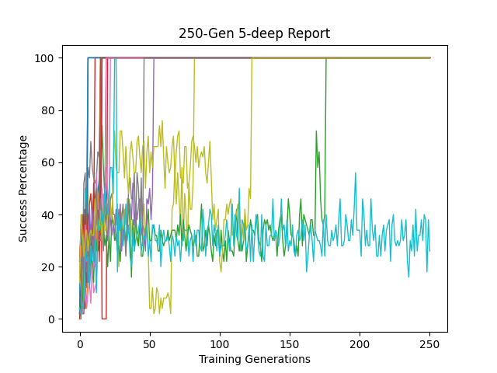
DEAP Results (20 run)
NEAT Results (20 run)
Results generated from testing champion of every generation against new set of data (50 example) that has never been seen before
Results generated from training fitness of every generation champion

Slide 13
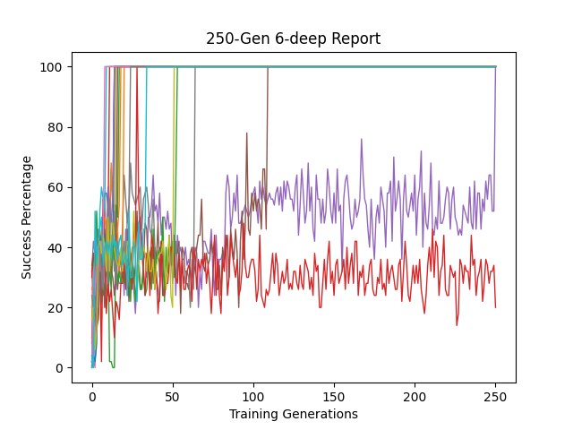
DEAP Results (20 run)
NEAT Results (20 run)
Results generated from testing champion of every generation against new set of data (50 example) that has never been seen before
Results generated from training fitness of every generation champion

Slide 14
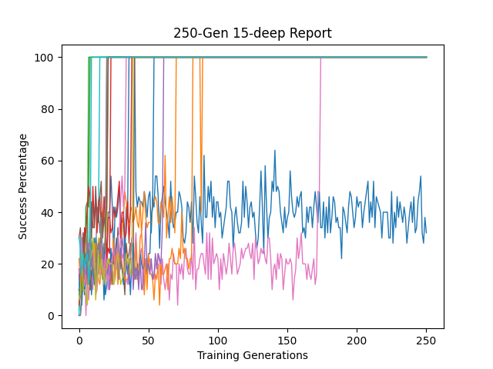
DEAP Results (20 run)
NEAT Results (20 run)
Results generated from testing champion of every generation against new set of data (50 example) that has never been seen before
Results generated from training fitness of every generation champion

Slide 15
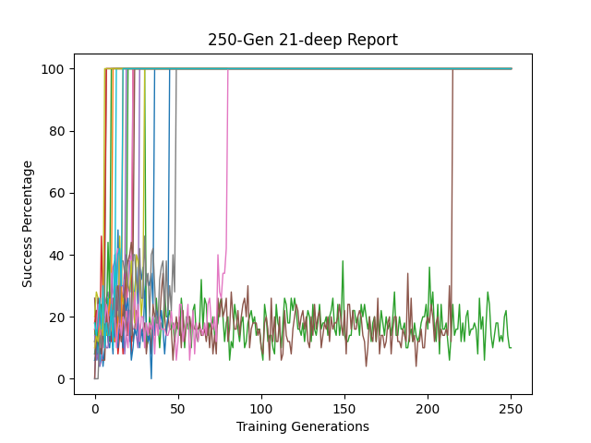
DEAP Results (20 run)
NEAT Results (20 run)
Results generated from testing champion of every generation against new set of data (50 example) that has never been seen before
Results generated from training fitness of every generation champion

Slide 16
deap vs deap
(Arithmetic operators)
(Logical operators)

Slide 17
Copy Task
In the standard approach the network used arithmetic operators (add, subtract, protected division).
We added to those operators some logical ones to study the effect that will have on the network.
Logical operators added are:
And, or, not
Less than, Equal, If_then_else
Random number generator
True, false
multiplication

Slide 18
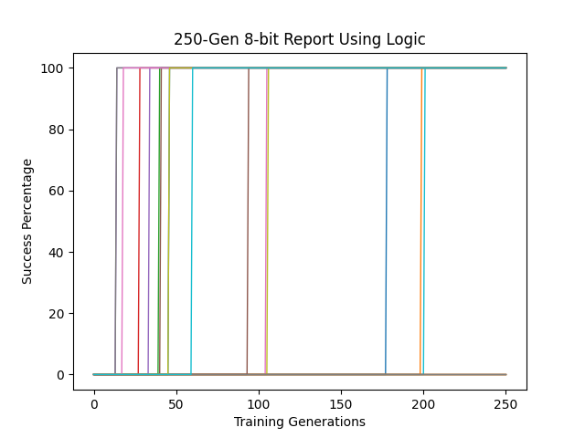
DEAP Results (20 run)
DEAP Results (20 run)
Using Arithmetic operators
With added logical operators

Slide 19
Sequence Recall
In the standard approach the network used arithmetic operators (add, subtract, protected division).
We added to those operators some logical ones to study the effect that will have on the network.
Logical operators added are:
And, or, not
Less than, Equal, If_then_else
Random number generator
True, false
multiplication

Slide 20
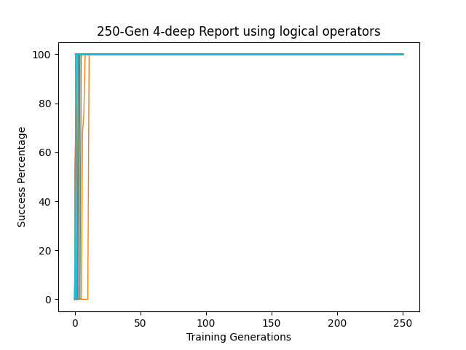
DEAP Results (20 run)
DEAP Results (20 run)
Using Arithmetic operators
With added logical operators

Slide 21
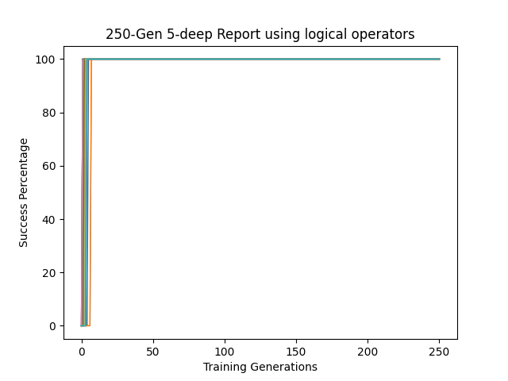
DEAP Results (20 run)
DEAP Results (20 run)
Using Arithmetic operators
With added logical operators

Slide 22
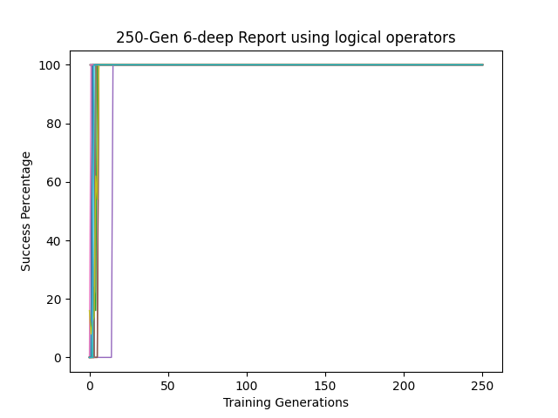
DEAP Results (20 run)
DEAP Results (20 run)
Using Arithmetic operators
With added logical operators

Slide 23
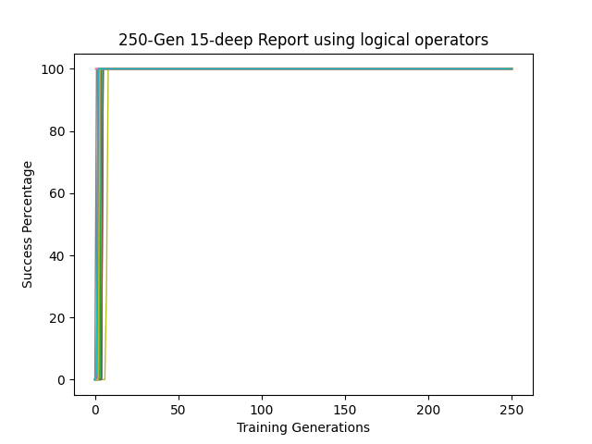
DEAP Results (20 run)
DEAP Results (20 run)
Using Arithmetic operators
With added logical operators

Slide 24
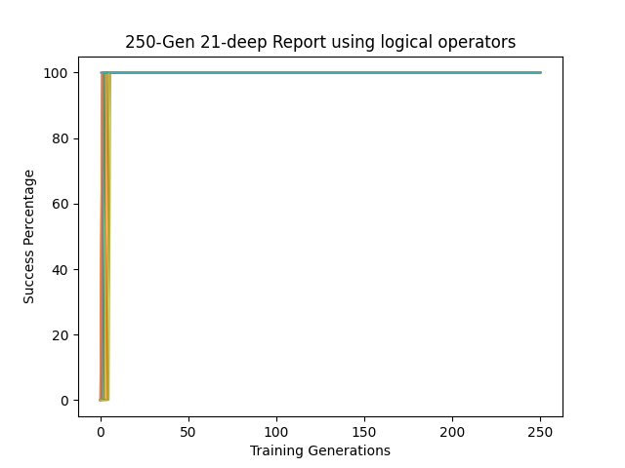
DEAP Results (20 run)
DEAP Results (20 run)
Using Arithmetic operators
With added logical operators

Slide 25
Sequence classification
In the standard approach the network used arithmetic operators (add, subtract, protected division).
We added to those operators some logical ones to study the effect that will have on the network.
Logical operators added are:
And, or, not
Less than, Equal, If_then_else
Random number generator
True, false
multiplication

Slide 26
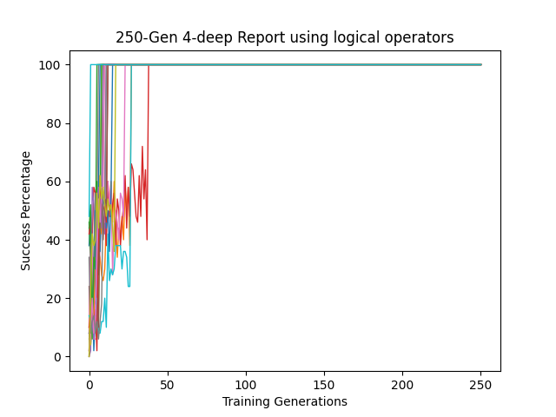
DEAP Results (20 run)
DEAP Results (20 run)
Using Arithmetic operators
With added logical operators

Slide 27
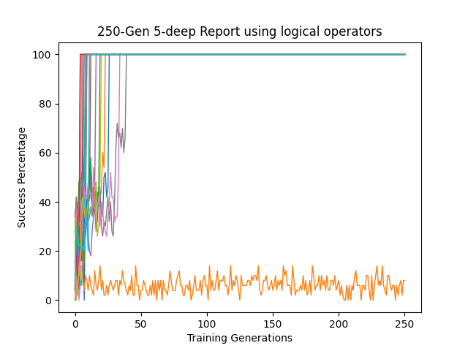
DEAP Results (20 run)
DEAP Results (20 run)
Using Arithmetic operators
With added logical operators

Slide 28
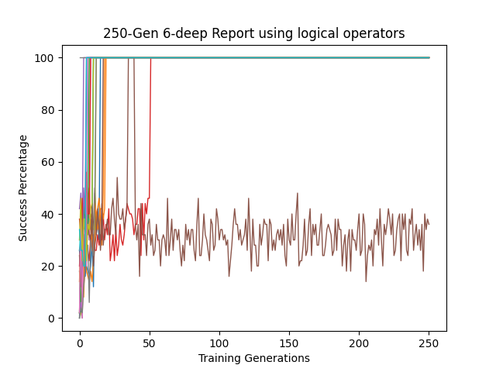
DEAP Results (20 run)
DEAP Results (20 run)
Using Arithmetic operators
With added logical operators

Slide 29
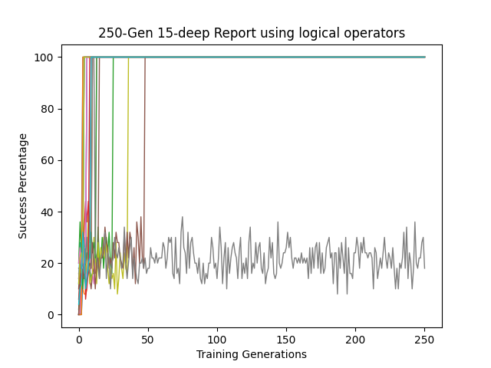
DEAP Results (20 run)
DEAP Results (20 run)
Using Arithmetic operators
With added logical operators

Slide 30
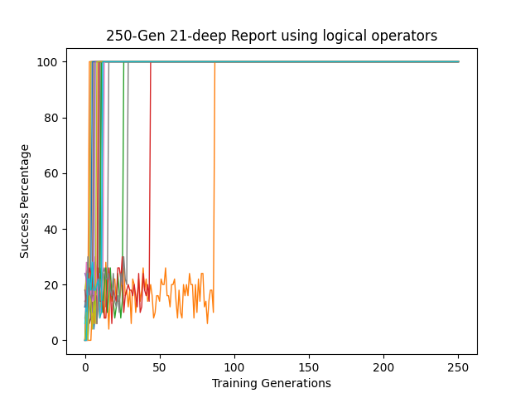
DEAP Results (20 run)
DEAP Results (20 run)
Using Arithmetic operators
With added logical operators

Slide 31
deap vs deap
(with protected division)
(with multiplication)

Slide 32
Copy Task
In the standard approach the network used protected division as linear function.
We replaced that function with multiplication operator.
Used operators are:
subtract
addition
multiplication

Slide 33
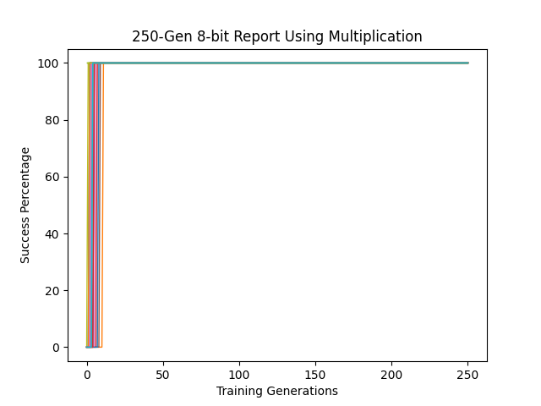
DEAP Results (20 run)
DEAP Results (20 run)
Using Protected Division
Using Multiplication

Slide 34
Sequence Recall
In the standard approach the network used protected division as linear function.
We replaced that function with multiplication operator.
Used operators are:
subtract
addition
multiplication

Slide 35
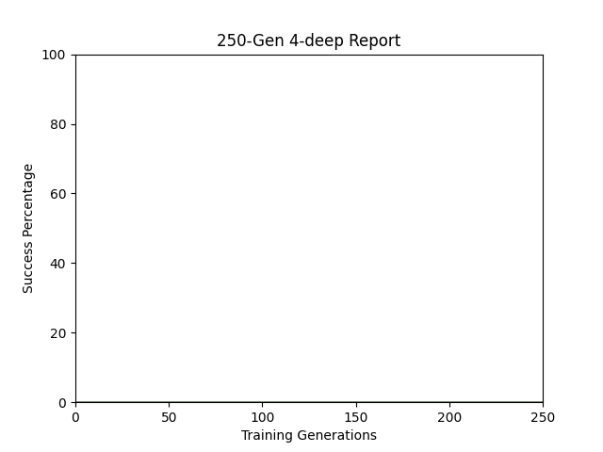
DEAP Results (20 run)
DEAP Results (20 run)
Using Protected Division
Using Multiplication

Slide 36

DEAP Results (20 run)
DEAP Results (20 run)
Using Protected Division
Using Multiplication

Slide 37
Sequence Classification
In the standard approach the network used protected division as linear function.
We replaced that function with multiplication operator.
Used operators are:
subtract
addition
multiplication

Slide 38
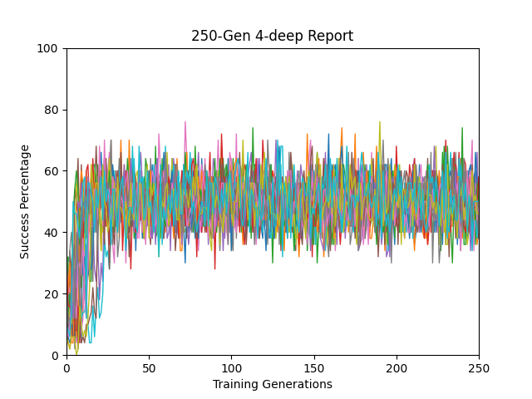
DEAP Results (20 run)
DEAP Results (20 run)
Using Protected Division
Using Multiplication

Slide 39
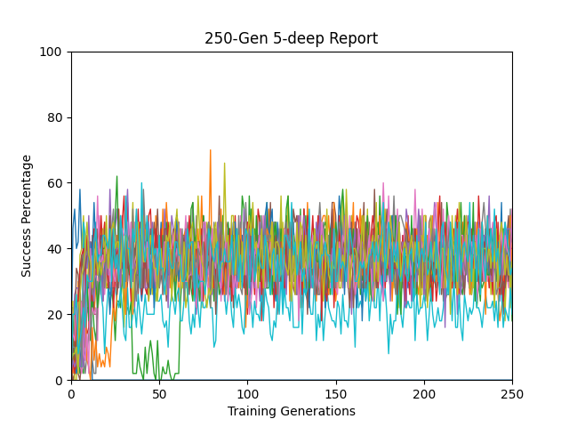
DEAP Results (20 run)
DEAP Results (20 run)
Using Protected Division
Using Multiplication

Slide 40
deap vs deap
(Standard)
(Modified)

Slide 41
Copy Task
In the standard approach the network used zeros for copy and past delimiters.
We modified the task to study the effect of changing delimiters on the results
Copy delimiter in standard is [1,0], in modified is [1,-1]
Paste delimiter in standard is [0,1], in modified is [-1,1]

Slide 42
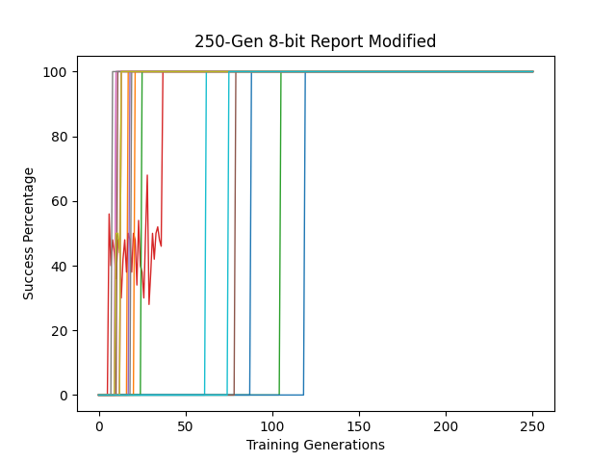
DEAP Results (20 run)
DEAP Results (20 run)
Standard
Modified

Slide 43
Sequence Recall
In the standard approach the network used [1,0] to signal instruction learning.
We modified the task to study the effect of changing instruction signal on the results with [1,-1].
In the standard approach the network performed action when countdown reached zero.
We also modified that so the task would take action when countdown reaches one.

Slide 44
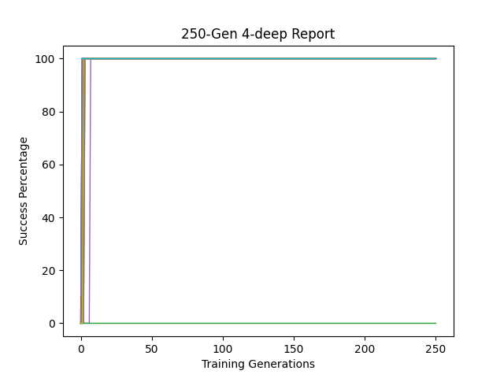
DEAP Results (20 run)
DEAP Results (20 run)
Standard
Modified

Slide 45
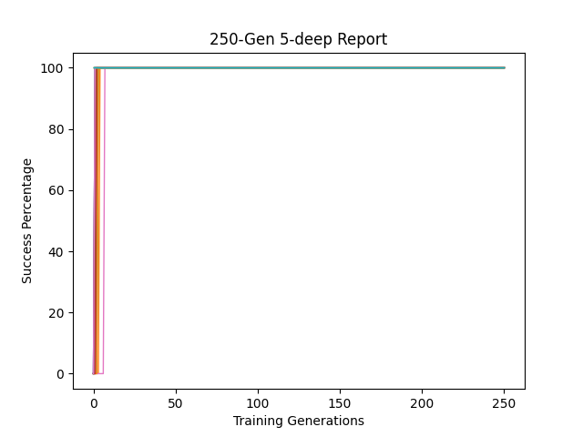
DEAP Results (20 run)
DEAP Results (20 run)
Standard
Modified

Slide 46
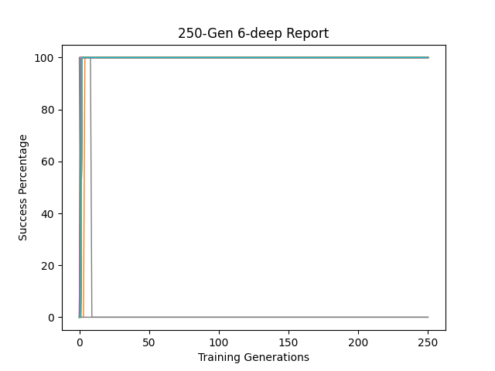
DEAP Results (20 run)
DEAP Results (20 run)
Standard
Modified

Slide 47
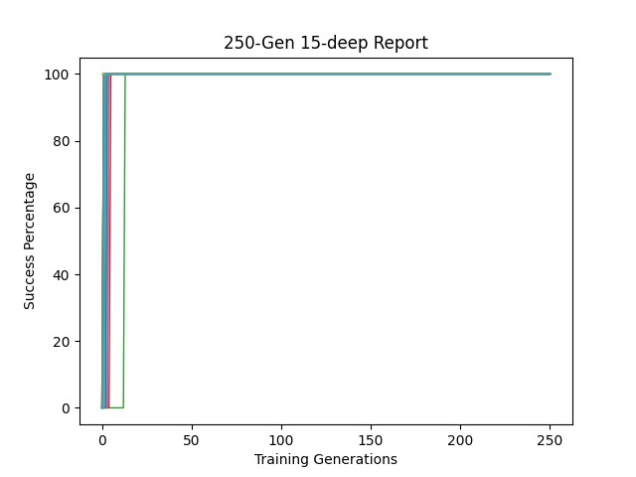
DEAP Results (20 run)
DEAP Results (20 run)
Standard
Modified

Slide 48
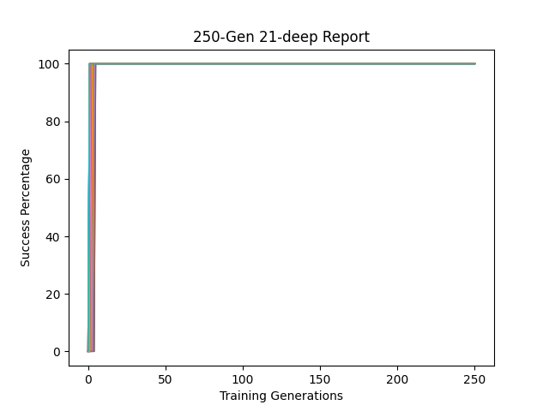
DEAP Results (20 run)
DEAP Results (20 run)
Standard
Modified

Slide 49
Sequence Classification
In the standard approach the network used zeros as noise.
We modified the task to study the effect of changing noise with random number generated between -0.5 to 0.5.
Then we tightened the noise range from -0.25 to 0.25.
Then we tightened the noise range from -0.125 to 0.125.

Slide 50
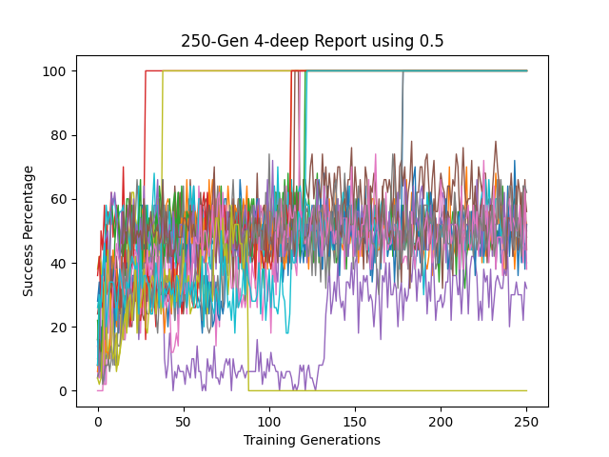
DEAP Results (20 run)
DEAP Results (20 run)
Standard
Modified to use 0.5

Slide 51
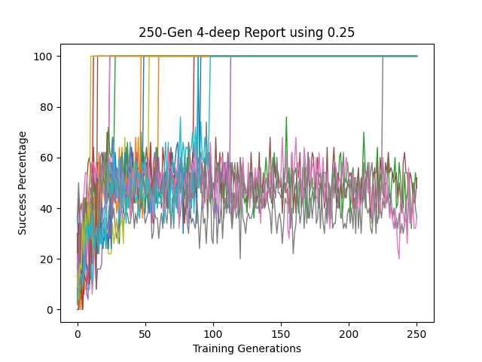
DEAP Results (20 run)
DEAP Results (20 run)
Standard
Modified to use 0.25

Slide 52
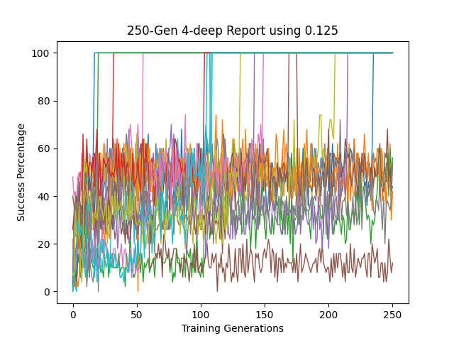
DEAP Results (20 run)
DEAP Results (20 run)
Standard
Modified to use 0.125

Slide 53
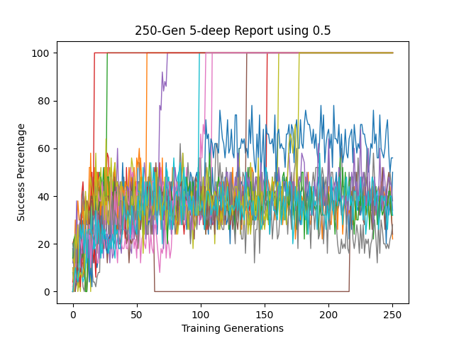
DEAP Results (20 run)
DEAP Results (20 run)
Standard
Using 0.5

Slide 54
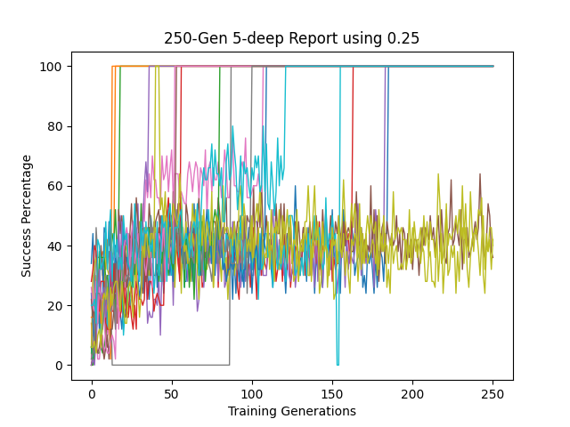
DEAP Results (20 run)
DEAP Results (20 run)
Standard
Using 0.25

Slide 55
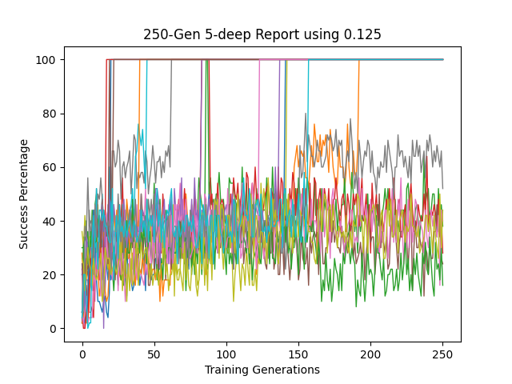
DEAP Results (20 run)
DEAP Results (20 run)
Standard
Using 0.125

Slide 56
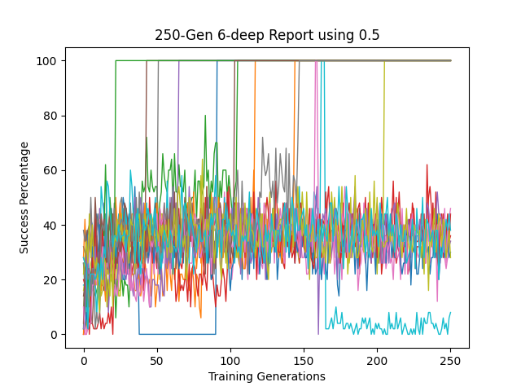
DEAP Results (20 run)
DEAP Results (20 run)
Standard
Using 0.5

Slide 57
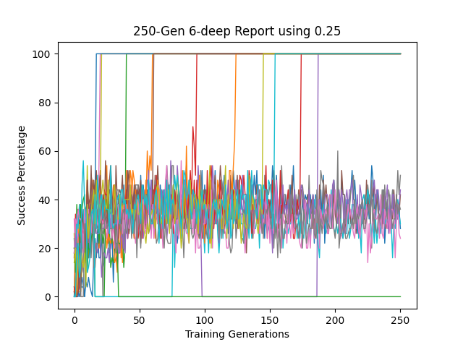
DEAP Results (20 run)
DEAP Results (20 run)
Standard
Using 0.25

Slide 58
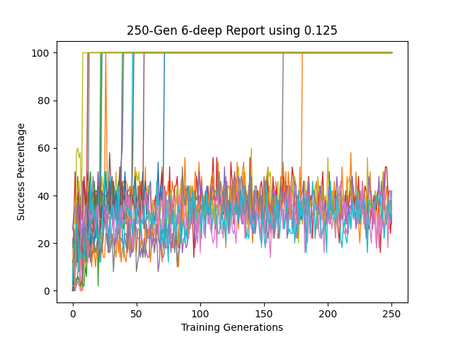
DEAP Results (20 run)
DEAP Results (20 run)
Standard
Using 0.125

Slide 59
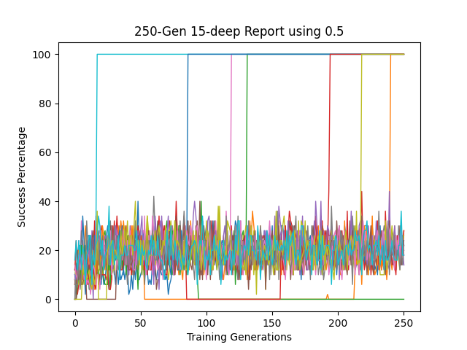
DEAP Results (20 run)
DEAP Results (20 run)
Standard
Using 0.5

Slide 60
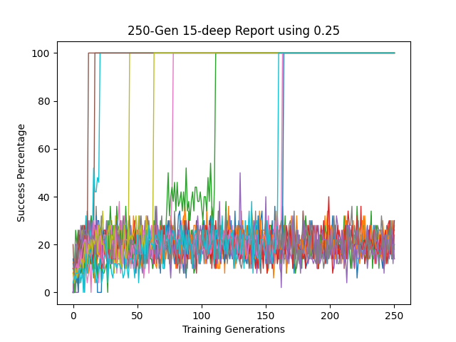
DEAP Results (20 run)
DEAP Results (20 run)
Standard
Using 0.25

Slide 61
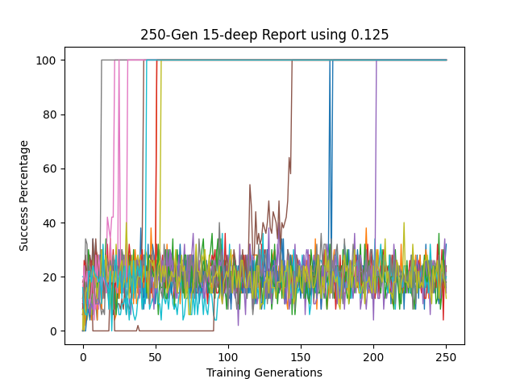
DEAP Results (20 run)
DEAP Results (20 run)
Standard
Using 0.125

Slide 62

DEAP Results (20 run)
DEAP Results (20 run)
Standard
Using 0.5

Slide 63

DEAP Results (20 run)
DEAP Results (20 run)
Standard
Using 0.25

Slide 64

DEAP Results (20 run)
DEAP Results (20 run)
Standard
Using 0.125

